Slide 1
Big Data Project Phase1
Jayashree Johnson

Slide 2
Flight Delay Analysis
Case 1: Top Airports with Highest Delays - Analyzed flight delay data to determine the top 3 airports with the most total arrival delay hours.
Case 2: Most Delayed Carriers - Used airline-level data to calculate total delay hours and identify which carriers had the most cumulative delays.
Case 3: Delay Type Comparison - Compared total arrival vs departure delays to classify if a location experiences more delay at arrival or departure.
Conclusion - Compared total arrival vs departure delays to classify if a location experiences more delay at arrival or departure.

Slide 3
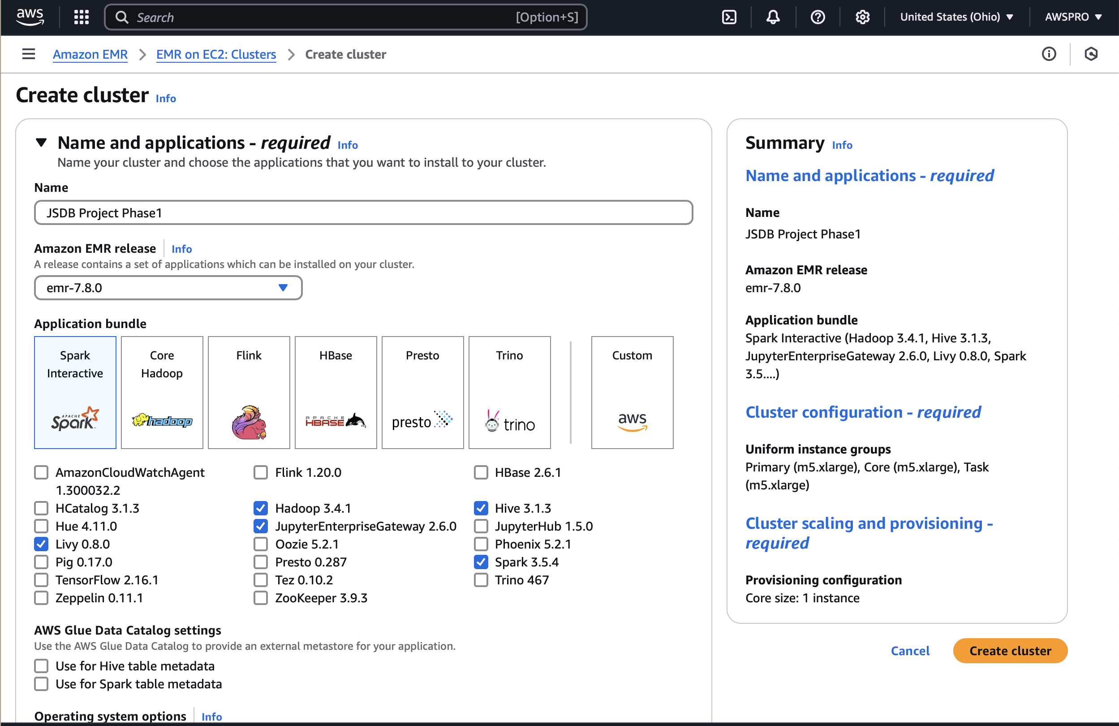
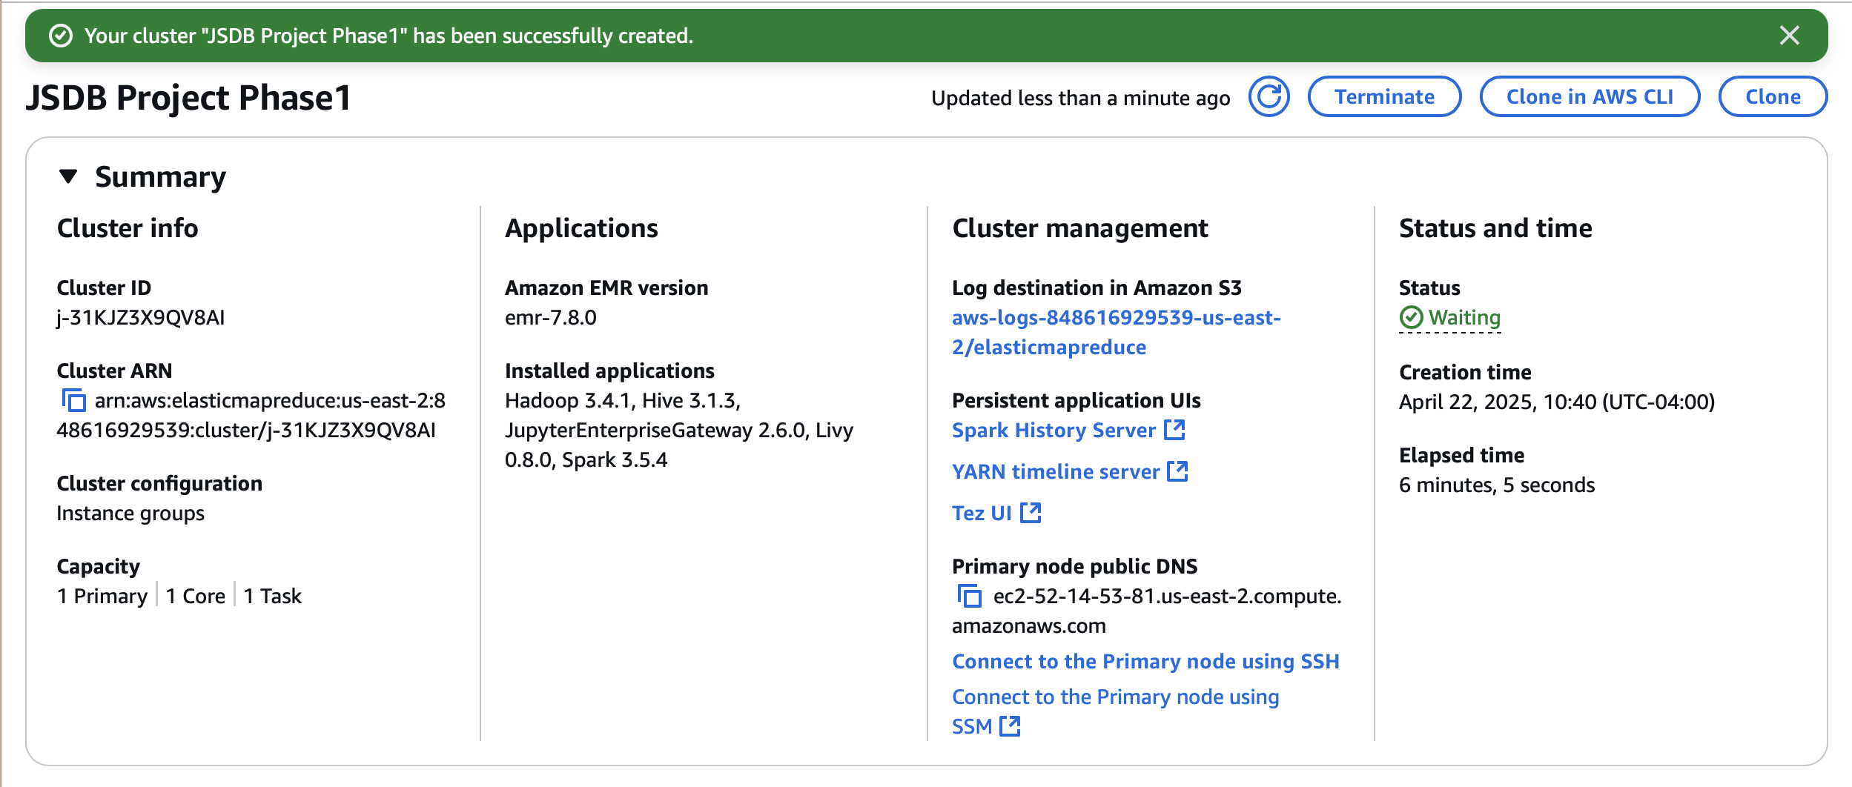
EMR Cluster

Slide 4

Dataset
Data Expo 2009: Airline on time data
Description: Contains flight arrival and departure details for all commercial flights within the USA for the year 2003.
Download Source: 2003
File: 2003.csv.bz2 (Compressed CSV)

Slide 5
2003 Dataset Upload
Step 1: Transferred local files (2003.csv, airports.csv, carriers.csv) to EMR using SCP:
scp -i ~/Downloads/SDB673\ Setup.pem 2003.csv hadoop@ec2-3-128-153-22.us-east-2.compute.amazonaws.com:/home/hadoop/
scp -i ~/Downloads/SDB673\ Setup.pem airports.csv hadoop@ec2-3-128-153-22.us-east-2.compute.amazonaws.com:/home/hadoop/
scp -i ~/Downloads/SDB673\ Setup.pem carriers.csv hadoop@ec2-3-128-153-22.us-east-2.compute.amazonaws.com:/home/hadoop/
Step 2: Connected to EMR via SSH and verified files:
ssh -i ~/Downloads/SDB673\ Setup.pem hadoop@ec2-3-128-153-22.us-east-2.compute.amazonaws.com
ls

Slide 6
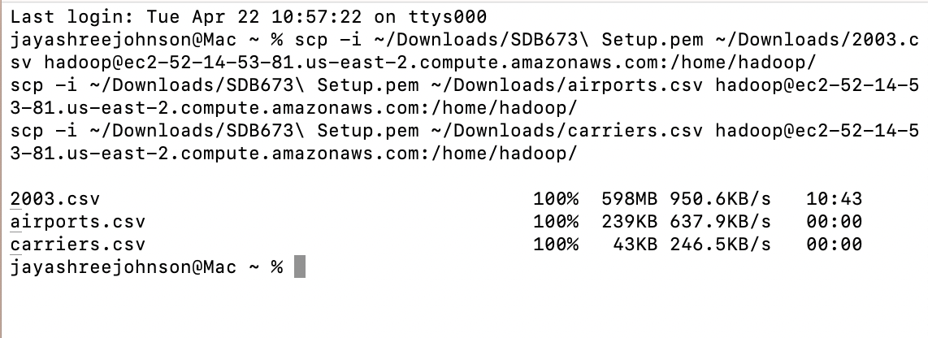
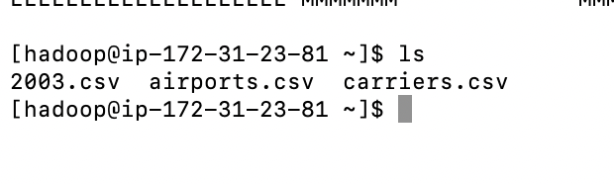

Data Transfer to EMR Cluster via SCP & SSH

Slide 7
Contd.,
Step 3: Uploaded CSVs to HDFS:
[hadoop@ip-172-31-25-231 ~]$ hdfs dfs -mkdir -p /user/hadoop/jayashree2003/
hdfs dfs -put 2003.csv /user/hadoop/jayashree2003/
hdfs dfs -put airports.csv /user/hadoop/jayashree2003/
hdfs dfs -put carriers.csv /user/hadoop/jayashree2003/
[hadoop@ip-172-31-25-231 ~]$ hdfs dfs -ls /user/hadoop/jayashree2003/
Step 4: Created Hive tables for flights, airports, and carriers:
CREATE TABLE jayashree_2003 (...)
CREATE TABLE airports (Code STRING, Description STRING)
CREATE TABLE carriers (Code STRING, Description STRING)

Slide 8
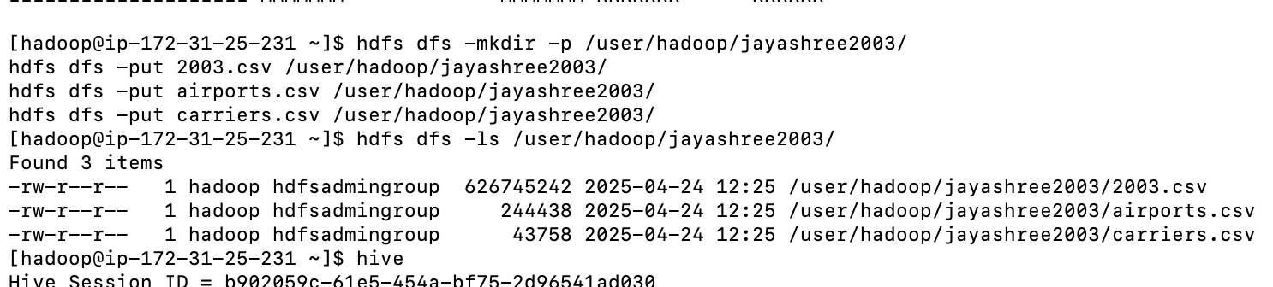
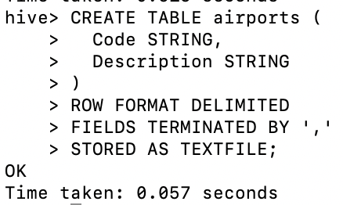
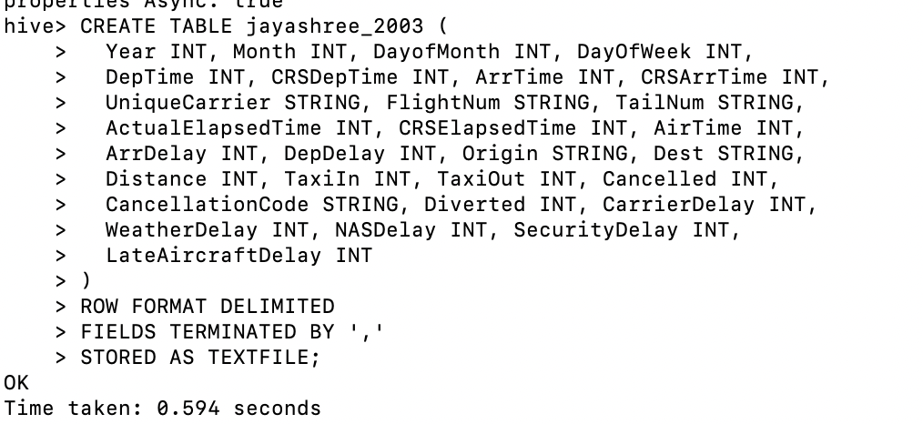
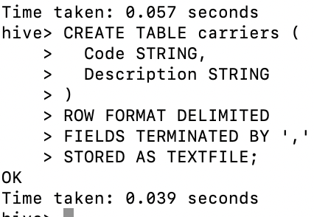
HDFS Upload and Hive Table Creation

Slide 9
Contd.,
Step 5: Loaded data into Hive tables:
LOAD DATA INPATH '/user/hadoop/jayashree2003/2003.csv' INTO TABLE jayashree_2003;
LOAD DATA INPATH '/user/hadoop/jayashree2003/airports.csv' INTO TABLE airports;
LOAD DATA INPATH '/user/hadoop/jayashree2003/carriers.csv' INTO TABLE carriers;

Slide 10
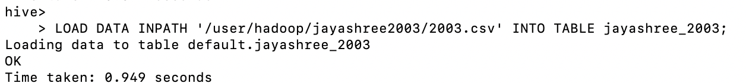
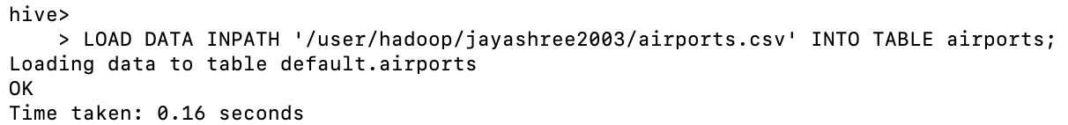

Loading HDFS Data into Hive Tables

Slide 11
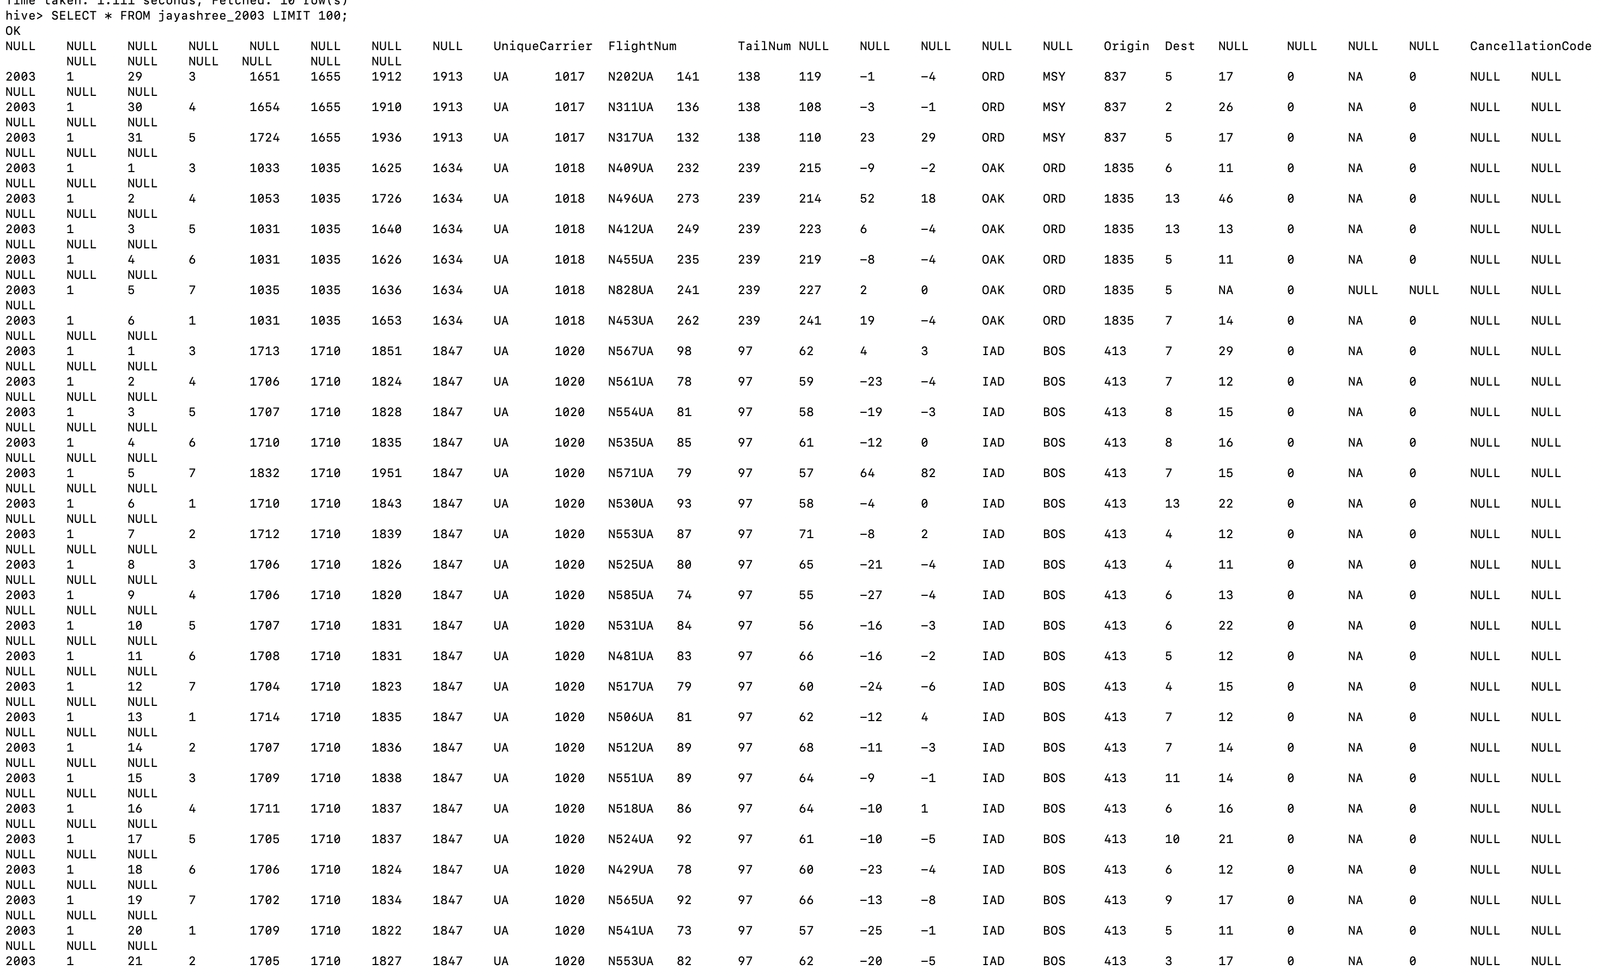
Preview of Hive Table: jayashree_2003

Slide 12

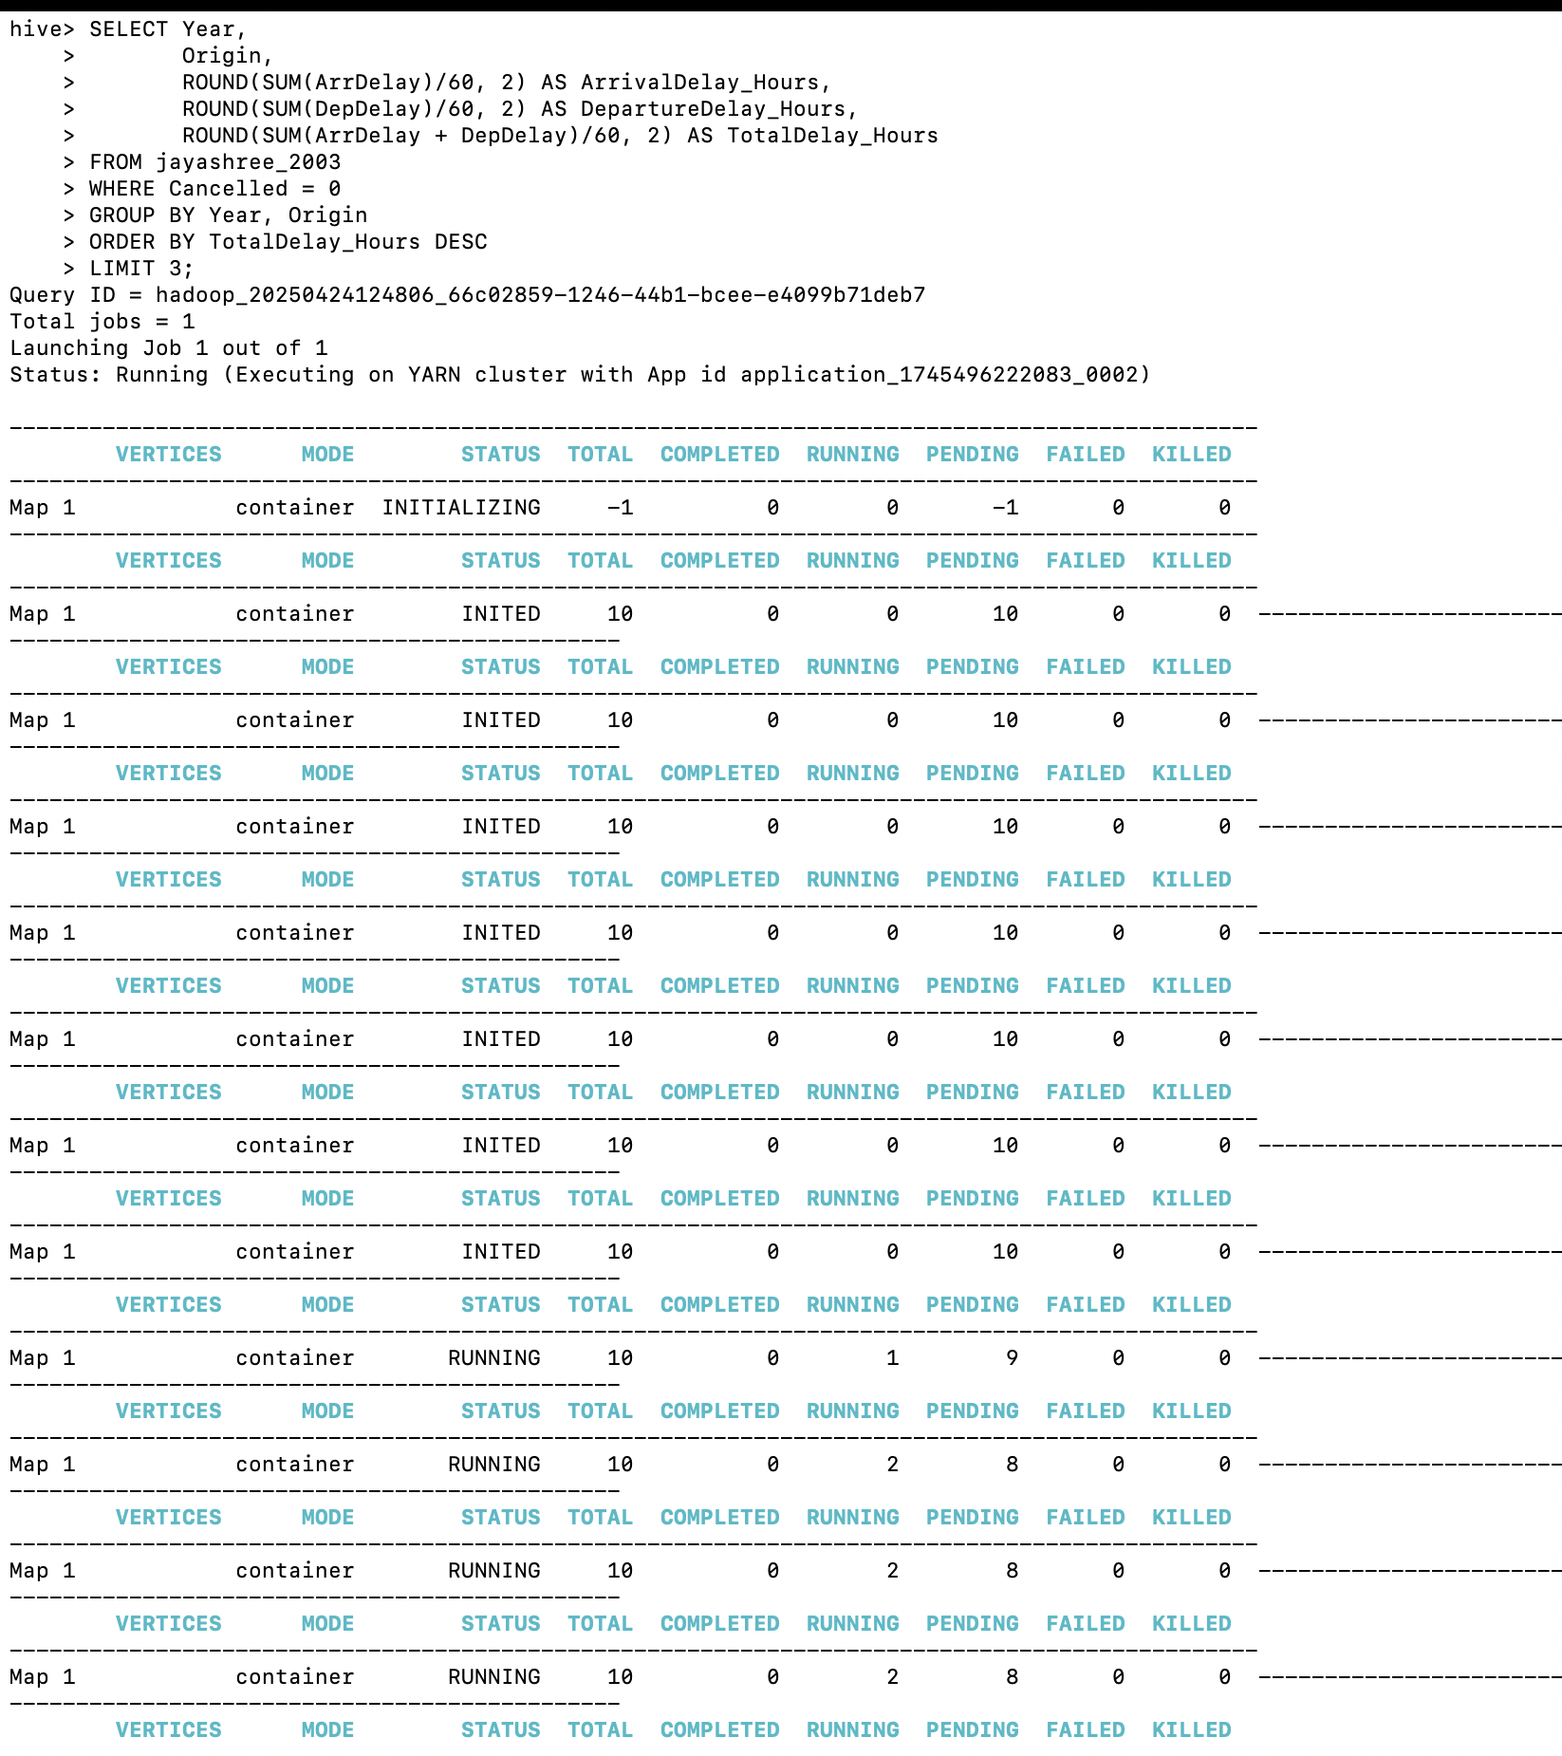
Case 1 Top 3 Origin Airports with Highest Delay (2003)
SELECT Year,
Origin,
ROUND(SUM(ArrDelay)/60, 2) AS ArrivalDelay_Hours,
ROUND(SUM(DepDelay)/60, 2) AS DepartureDelay_Hours,
ROUND(SUM(ArrDelay + DepDelay)/60, 2) AS TotalDelay_Hours
FROM jayashree_2003
WHERE Cancelled = 0
GROUP BY Year, Origin
ORDER BY TotalDelay_Hours DESC
LIMIT 3;

Slide 13
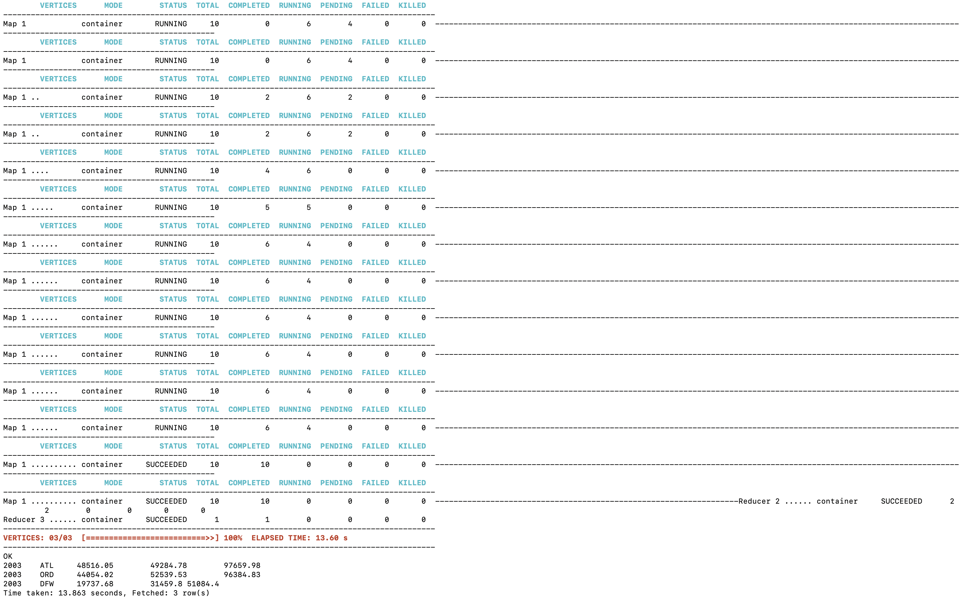

Slide 14
Case 1 Results
Year | Origin Airport | Arrival Delay (Hrs) | Departure Delay (Hrs) | Total Delay (Hrs)
2003 | Hartsfield–Jackson Atlanta (ATL) | 48,516.05 | 49284.78 | 97659.98
2003 | Chicago O’Hare (ORD) | 44054.02 | 52539.53 | 96384.83
2003 | Dallas Fort Worth (DFW) | 19737.68 | 31459.80 | 51084.40

Slide 15
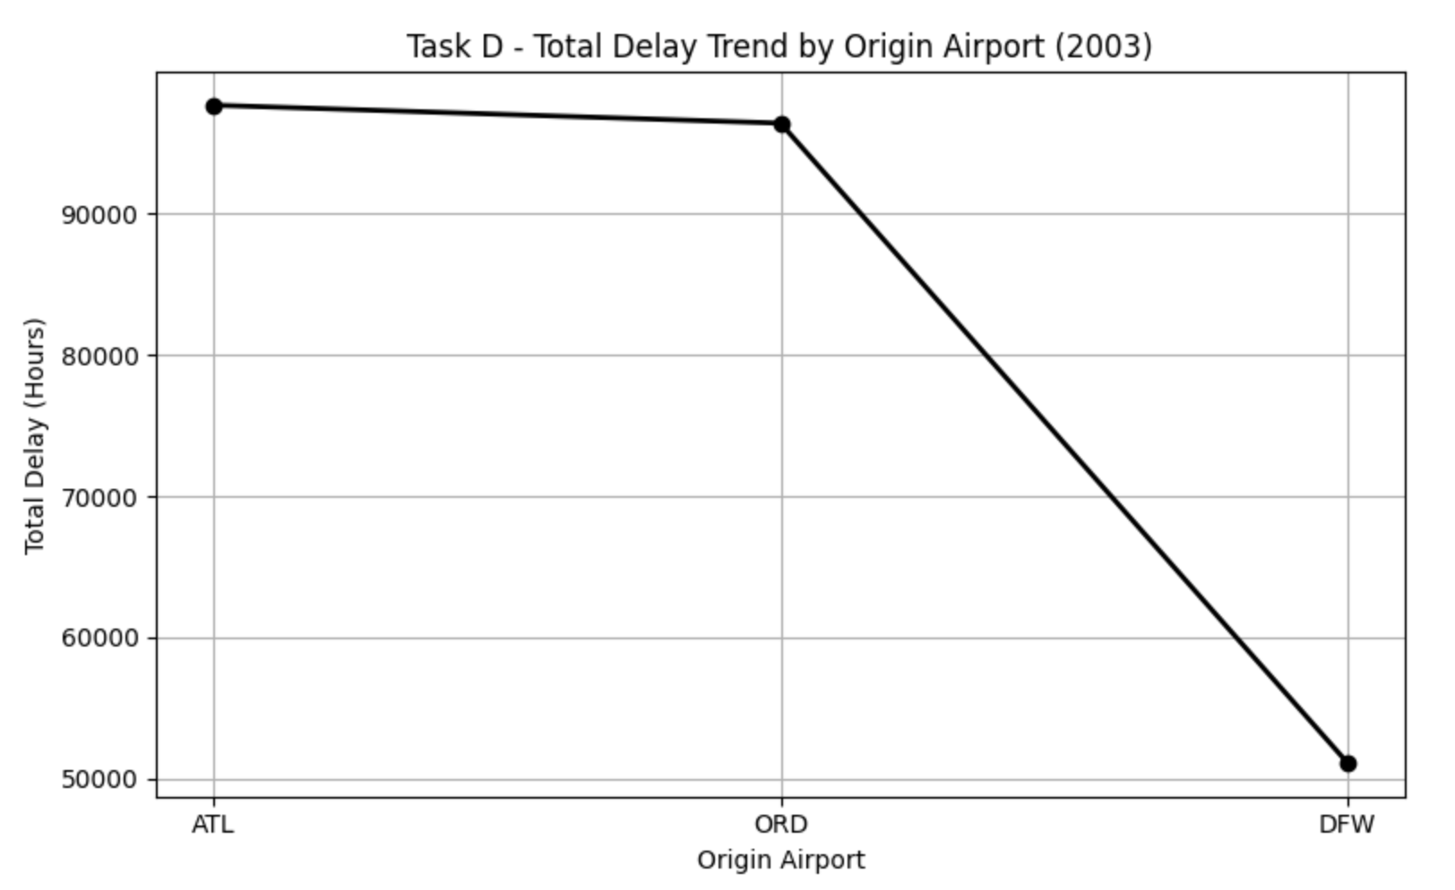
Contd.,
Insights – Origin Airports
ATL (Atlanta) had the highest total delay (97,659.98 hours), followed closely by ORD (Chicago O’Hare) with 96,384.83 hours.
These delays were nearly evenly split between arrival and departure.
DFW (Dallas Fort Worth), while third, had significantly less delay overall.
This suggests that major hubs like ATL and ORD are more prone to high traffic and systemic delays.

Slide 16

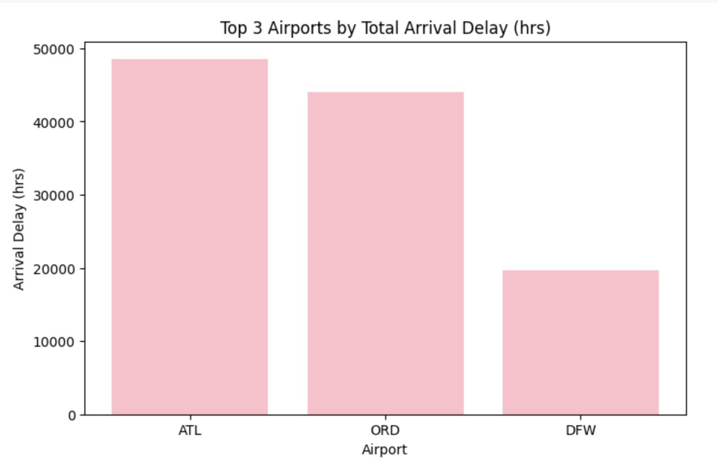
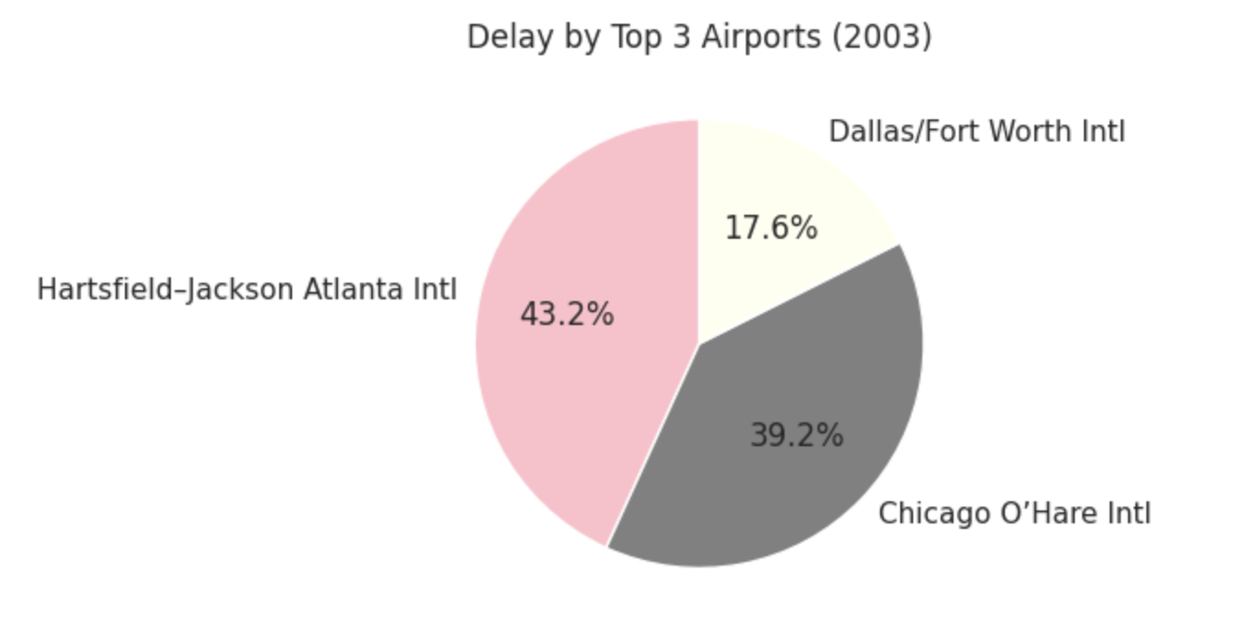
Top 3 Origin Airports with Highest Delay (2003)

Slide 17
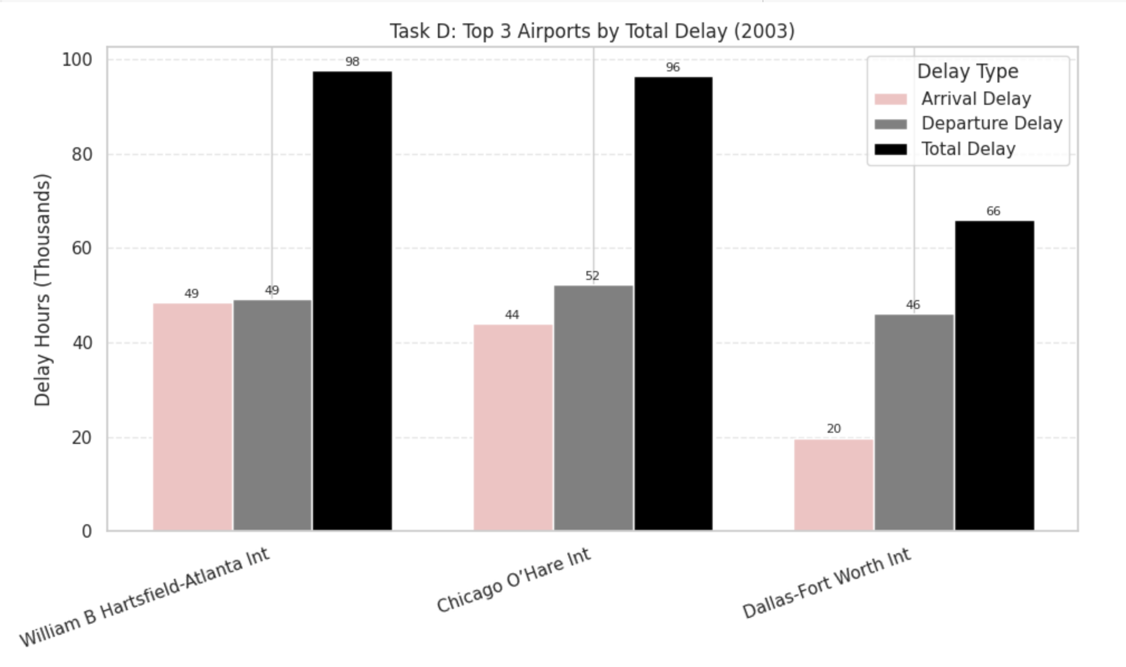
Arrival, Departure & Combined Delays Visualized

Slide 18
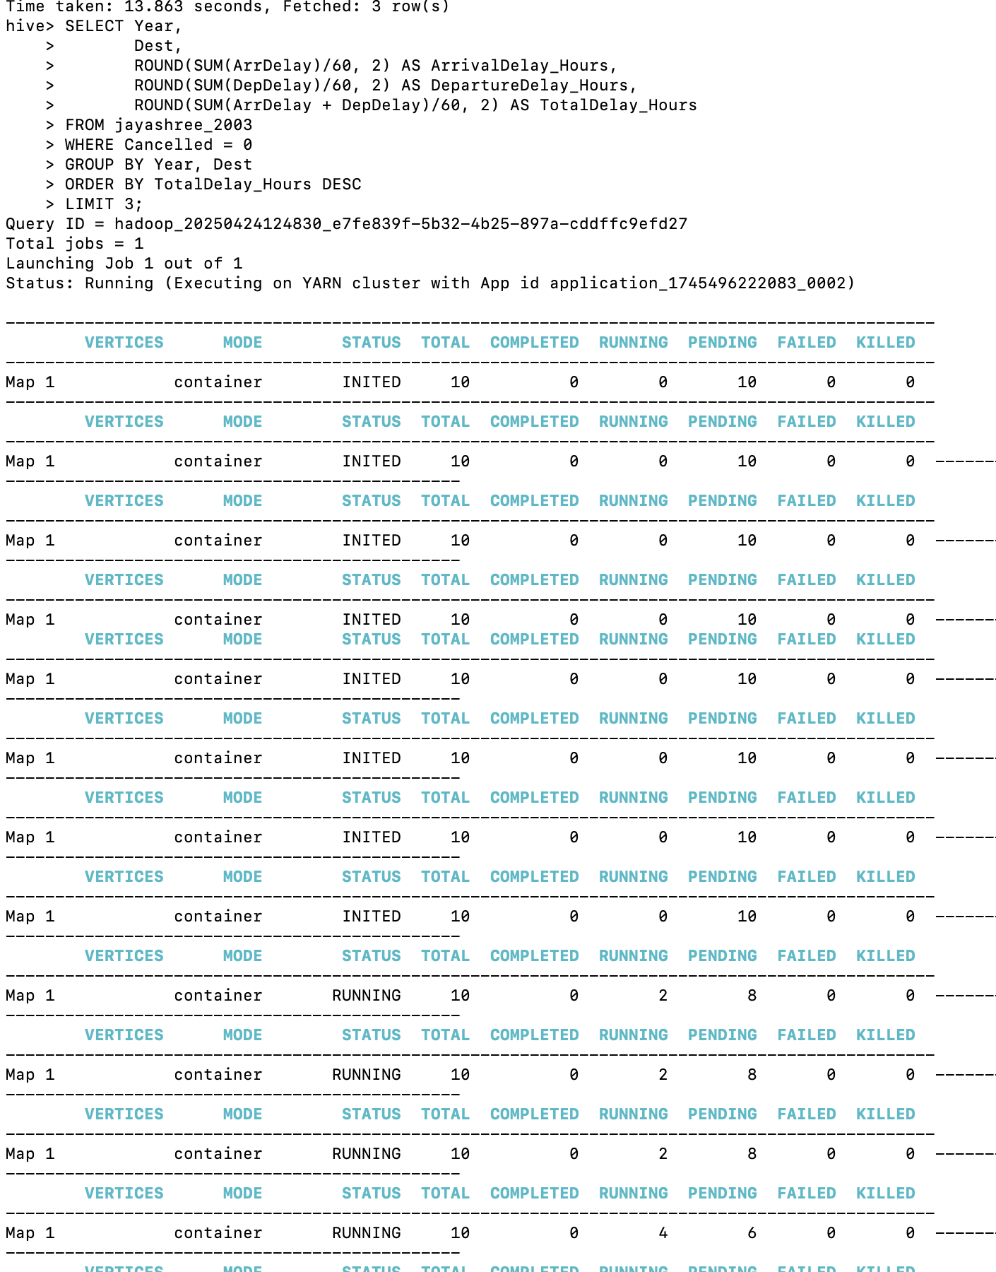
Top 3 Destination Airports with Highest Delay (2003)
SELECT Year,
Dest,
ROUND(SUM(ArrDelay)/60, 2) AS ArrivalDelay_Hours,
ROUND(SUM(DepDelay)/60, 2) AS DepartureDelay_Hours,
ROUND(SUM(ArrDelay + DepDelay)/60, 2) AS TotalDelay_Hours
FROM jayashree_2003
WHERE Cancelled = 0
GROUP BY Year, Dest
ORDER BY TotalDelay_Hours DESC
LIMIT 3;

Slide 19
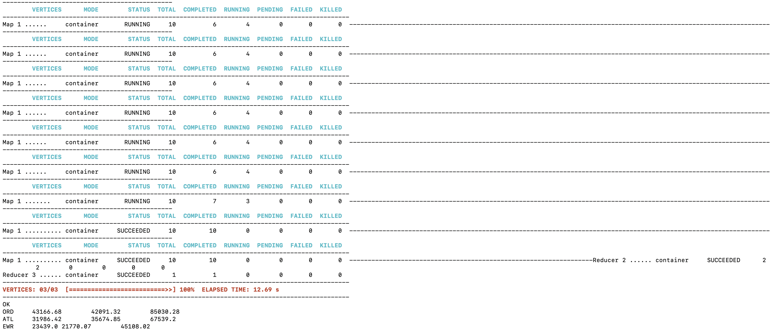

Slide 20
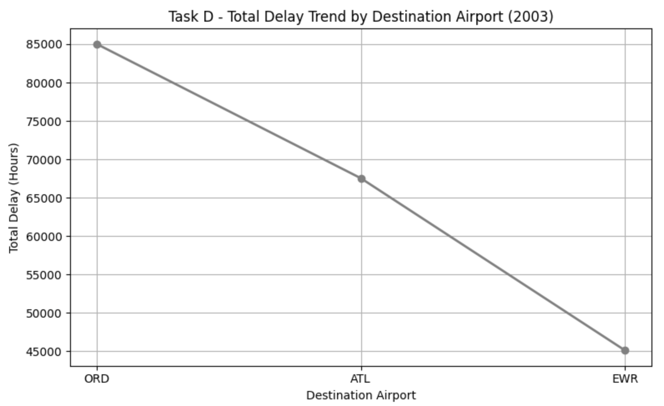
Case 1 Results
Year | Destination Airport | Arrival Delay (Hrs) | Departure Delay (Hrs) | Total Delay (Hrs)
2003 | Chicago O’Hare (ORD) | 43,166.68 | 42,091.32 | 85,030.28
2003 | Hartsfield–Jackson Atlanta (ATL) | 31,986.42 | 35,674.85 | 67,539.20
2003 | Newark International (EWR) | 23,439.00 | 21,770.07 | 45,108.02

Slide 21
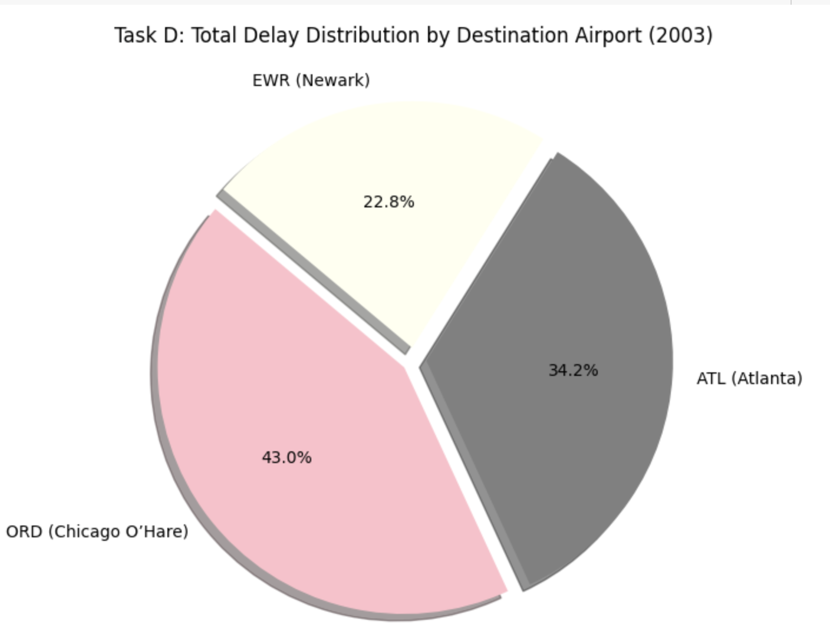
CONTD.,
Insights – Destination Airports
As a destination, ORD topped the list with 85,030.28 hours of delay, confirming its critical congestion point role.
ATL and EWR (Newark) followed, showing that both origin and destination status contribute to delay magnitude.
Airports like EWR may face infrastructure limitations and weather-related issues.

Slide 22
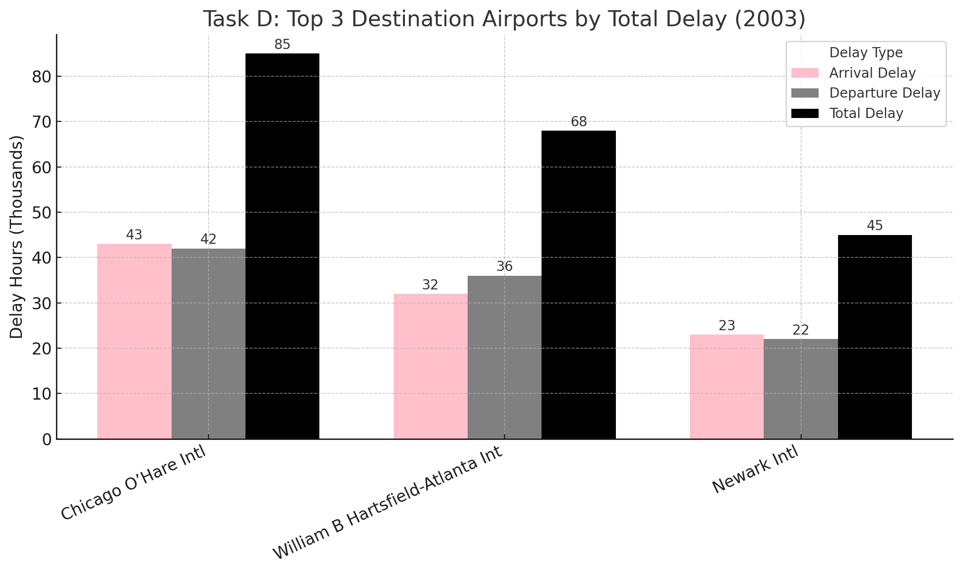

Slide 23
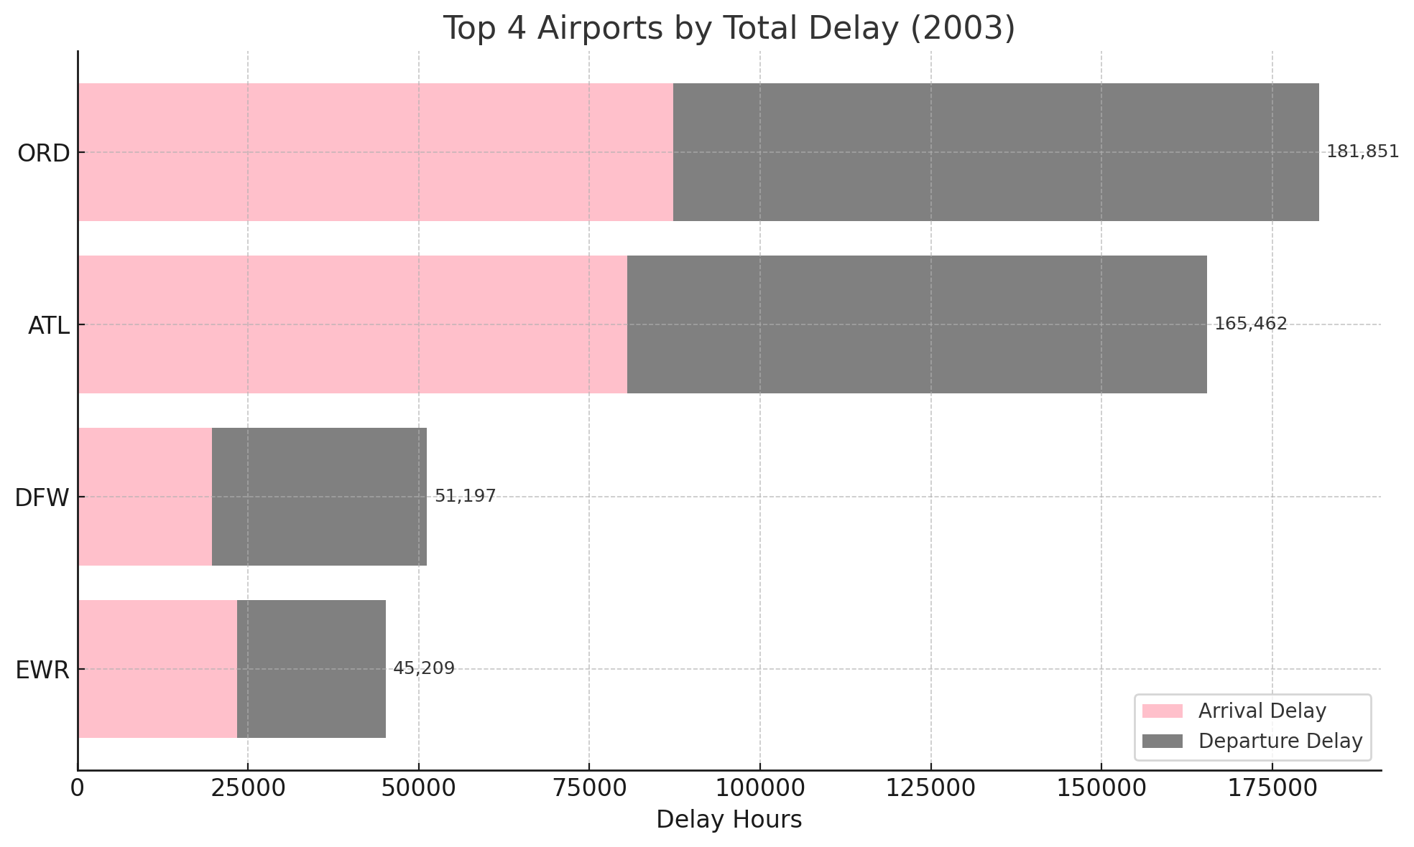

Slide 24
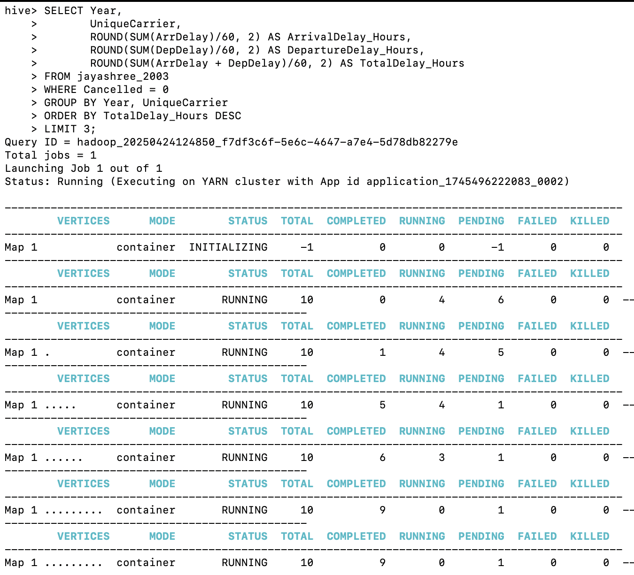
CASE 2 three carriers with the highest delay time (in hours) in 2003
SELECT Year,
> UniqueCarrier,
> ROUND(SUM(ArrDelay)/60, 2) AS ArrivalDelay_Hours,
> ROUND(SUM(DepDelay)/60, 2) AS DepartureDelay_Hours,
> ROUND(SUM(ArrDelay + DepDelay)/60, 2) AS TotalDelay_Hours
> FROM jayashree_2003
> WHERE Cancelled = 0
> GROUP BY Year, UniqueCarrier
> ORDER BY TotalDelay_Hours DESC
> LIMIT 3;

Slide 25
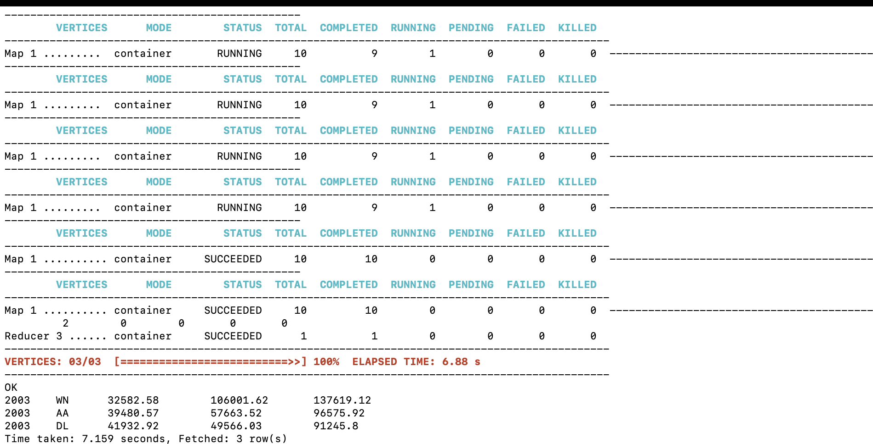

Slide 26
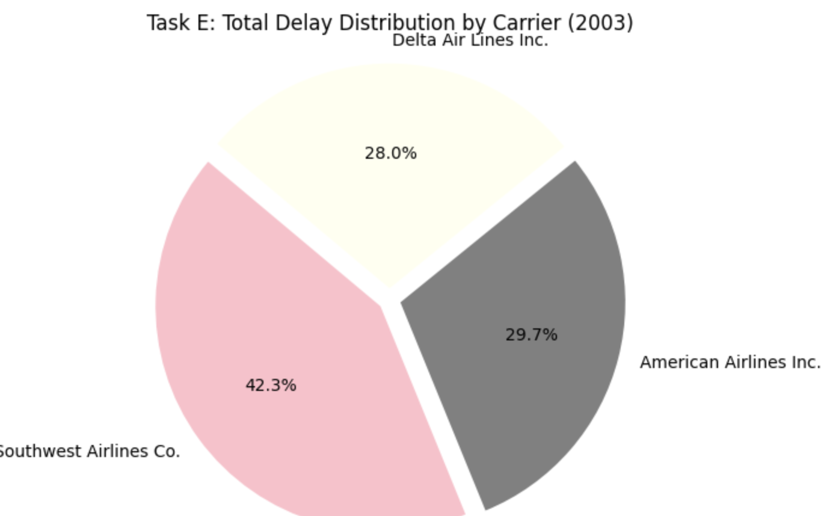
CASE 2 RESULTS
Year | Carrier | Arrival Delay (Hrs) | Departure Delay (Hrs) | Total Delay (Hrs)
2003 | Southwest Airlines Co. (WN) | 32,582.58 | 106,001.62 | 137,619.12
2003 | American Airlines Inc. (AA) | 39,480.57 | 57,663.52 | 96,575.92
2003 | Delta Air Lines Inc. (DL) | 41,932.92 | 49,656.03 | 91,245.80

Slide 27
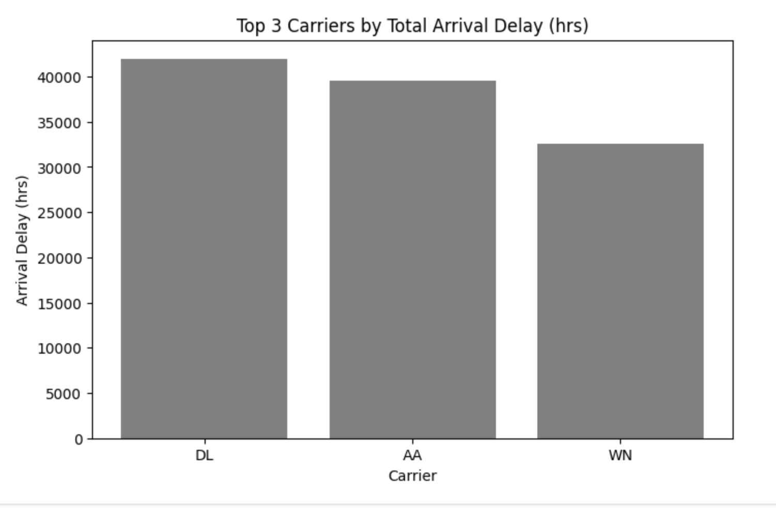
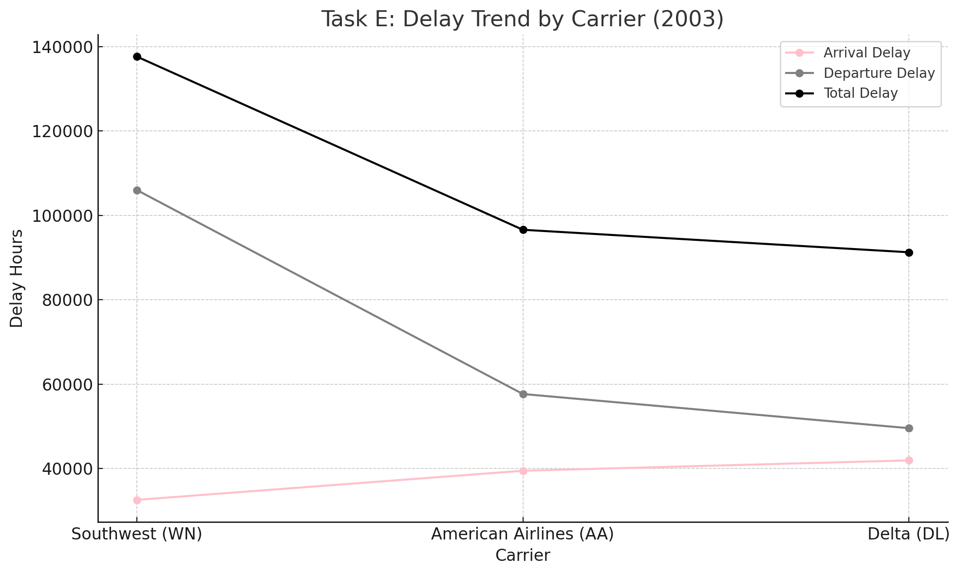
TOP 3 CARRIERS BY TOTAL DELAY (IN HOURS)
Insights:
Southwest Airlines (WN) had the highest total delay (137,619.12 hours), with the majority being departure delay(106,001.62 hours).
This points to operational or scheduling inefficiencies despite Southwest’s fast turnaround reputation.
American Airlines (AA) and Delta (DL) followed, with more balanced arrival/departure delays.
These results indicate that high-volume carriers with hub operations in major airports face compounding delays.

Slide 28
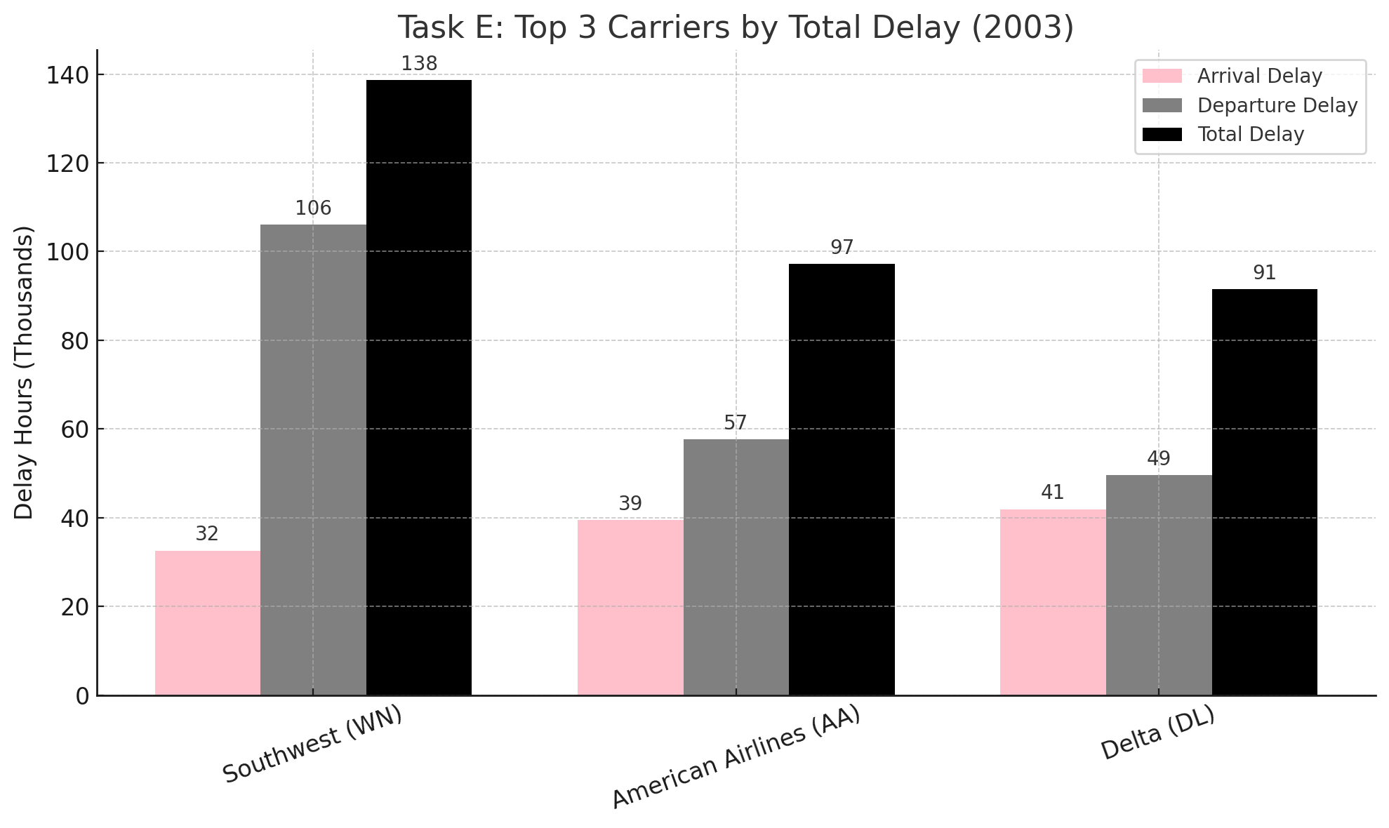
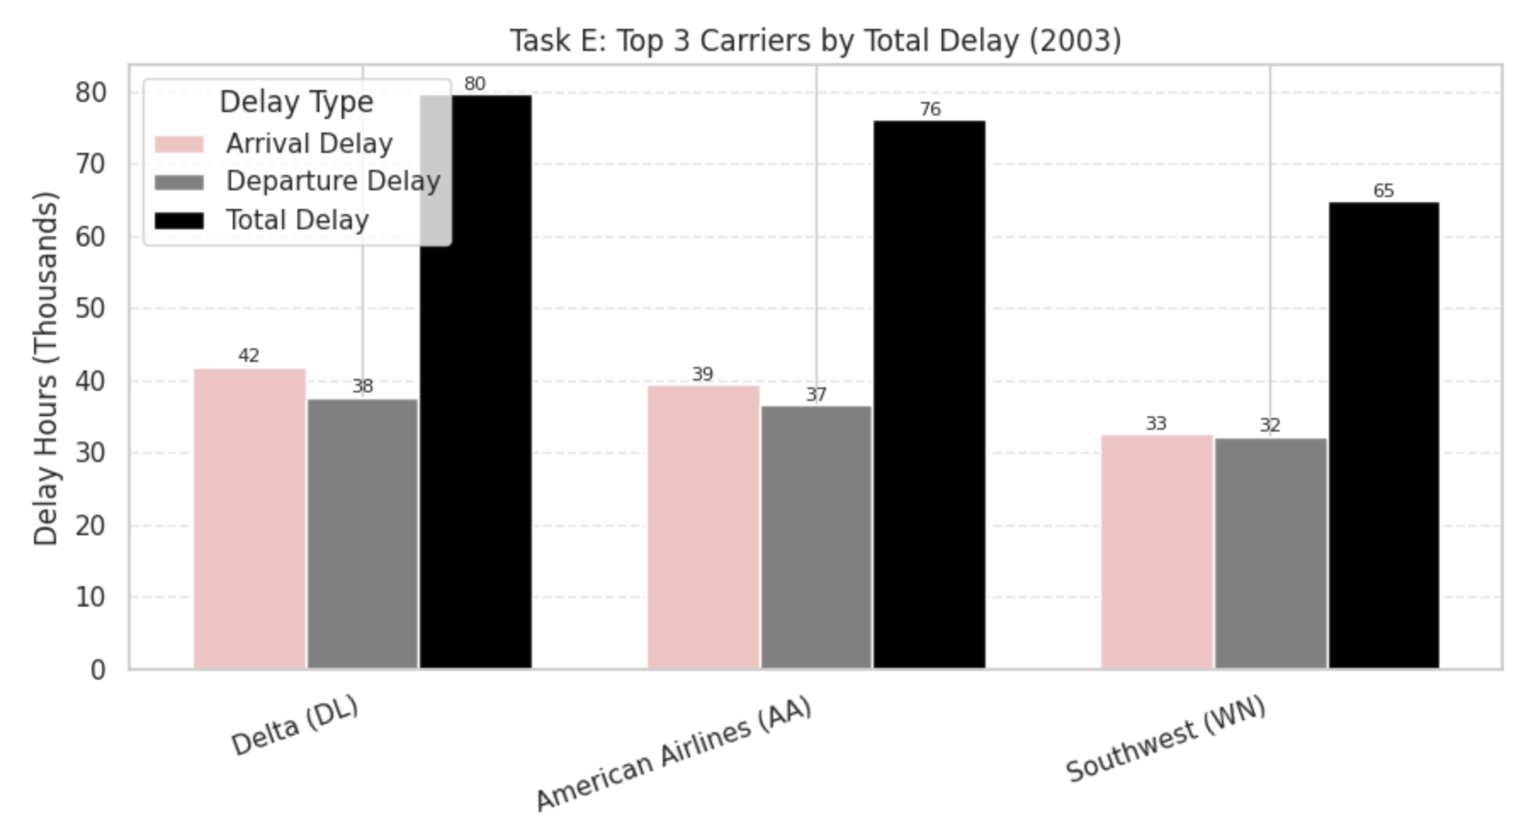

Slide 29
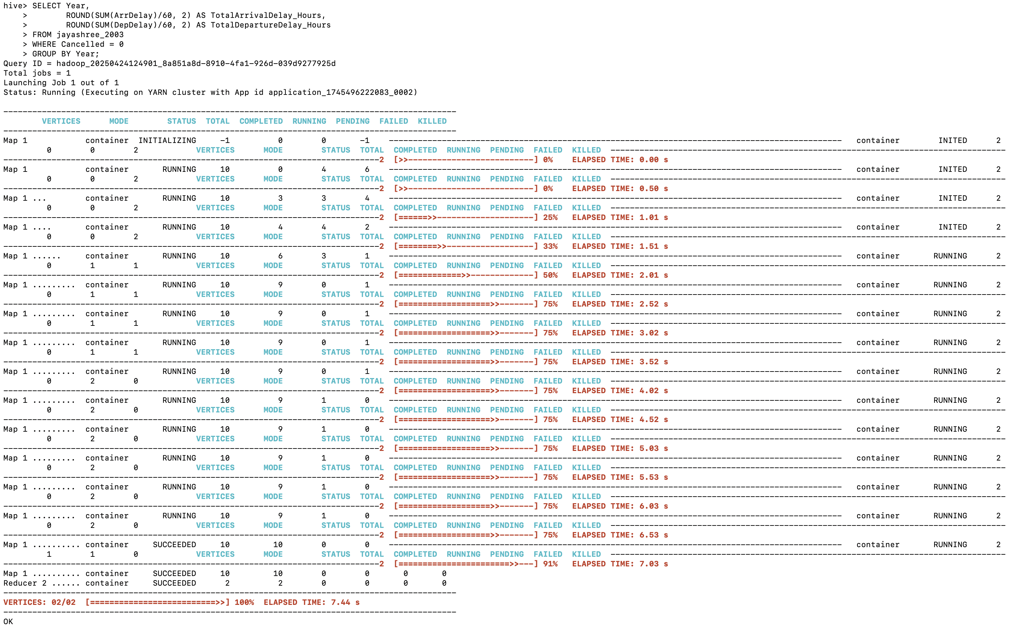
CASE 3
SELECT Year,
ROUND(SUM(ArrDelay)/60, 2) AS TotalArrivalDelay_Hours,
ROUND(SUM(DepDelay)/60, 2) AS TotalDepartureDelay_Hours
FROM jayashree_2003
WHERE Cancelled = 0
GROUP BY Year;

Slide 30
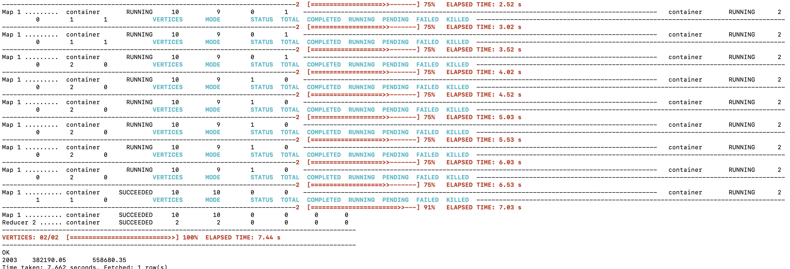

Slide 31
CASE 3 RESULTS Determine overall which type of delay (arrivals or departures) is the largest for airports
Metric | Total Hours
Arrival Delay Hours | 382190.05
Departure Delay Hours | 558680.35

Slide 32
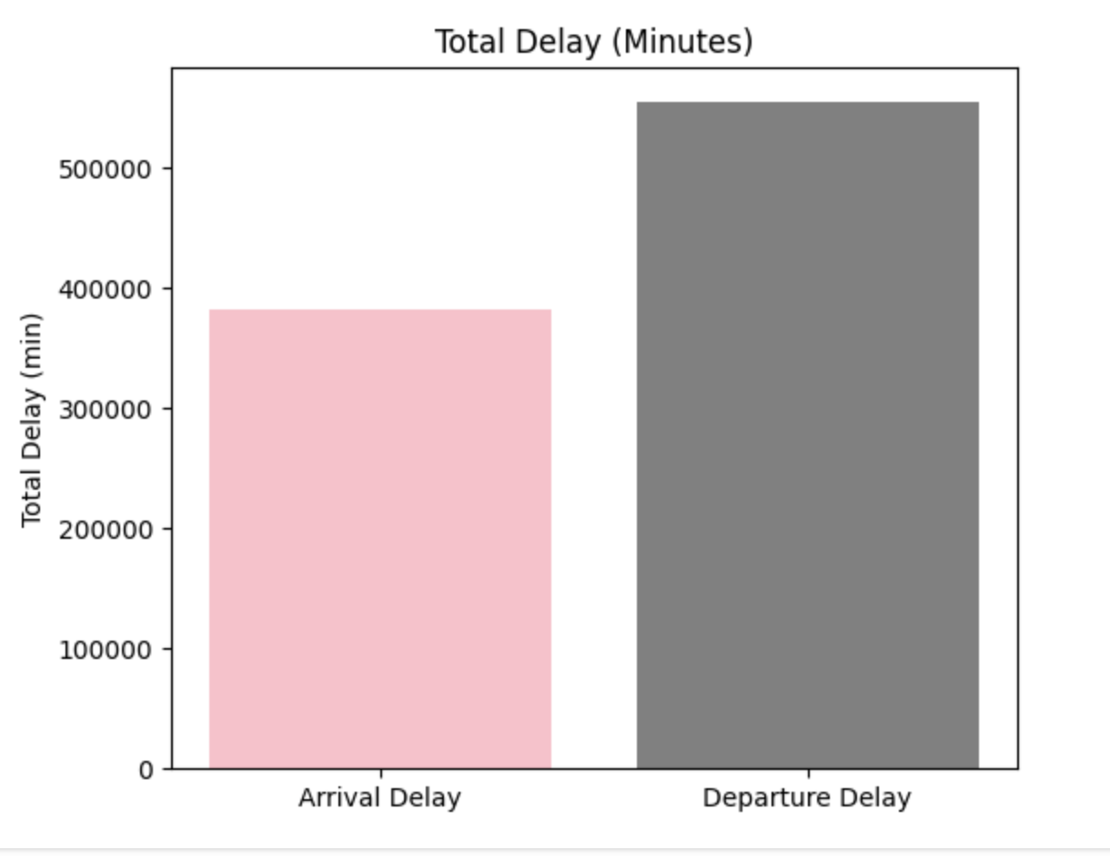
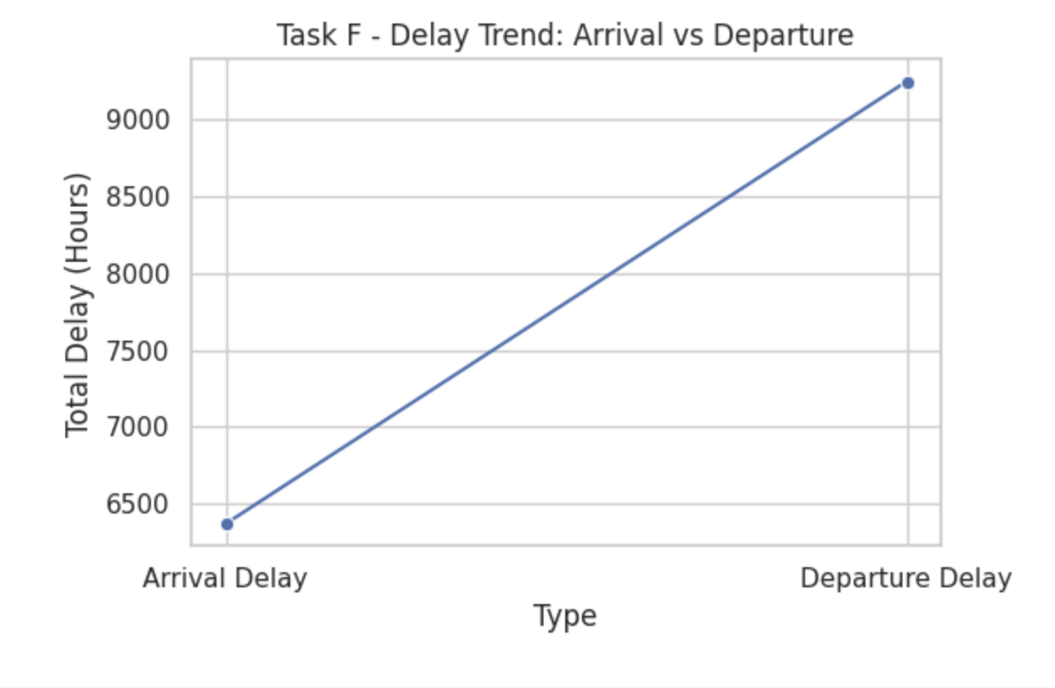
CONTD.,
Insights:
Departure delays dominated with a total of 558,680.35 hours, compared to 382,190.05 hours for arrival delays.
This suggests that ground-side operations, airport congestion, and late aircraft turnarounds play a greater role in delay accumulation.
Managing departure efficiency could be a key strategy in reducing overall system delay.

Slide 33
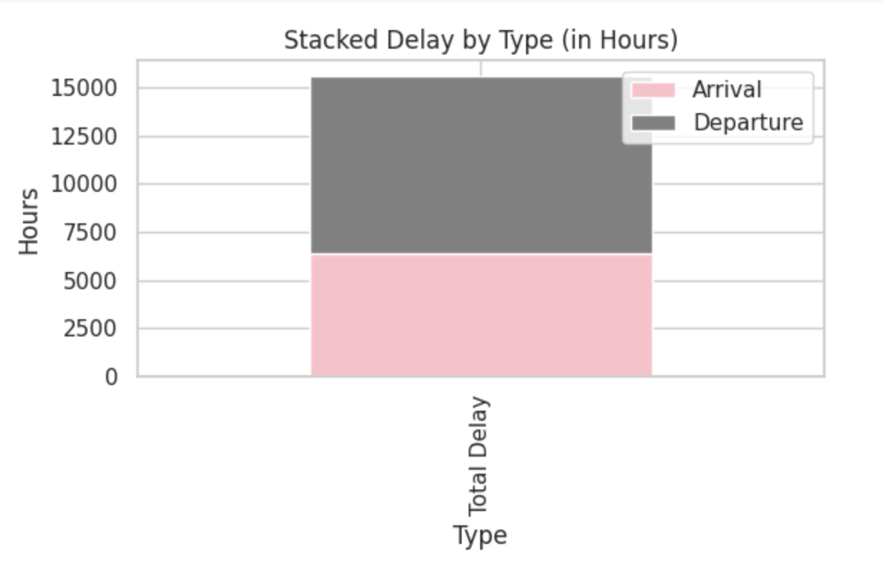

Slide 34
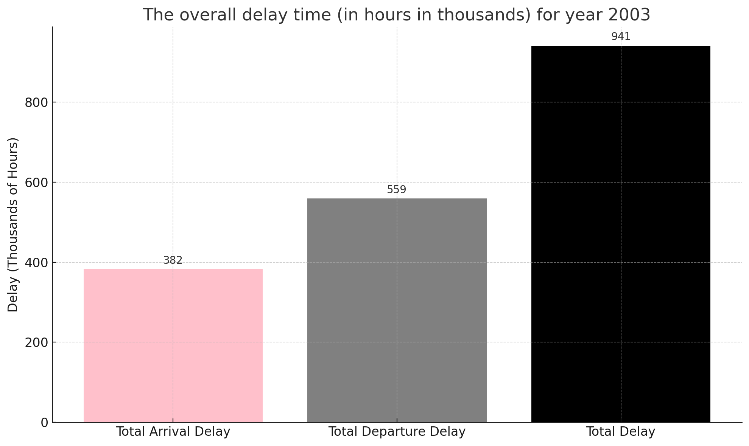

Slide 35
